Slide 1

Information and Network Security(INS)

Slide 2
INS - Lecture 11 Presented by: Drashti Shrimal

Slide 3
UNIT 1: Topics in this presentation
Substitution Techniques (Part 2):
- Playfair Cipher

Slide 4
Substitution Techniques in Encryption
3. Playfair Cipher
More than one character is used for encryption and decryption.
Hence it is called as Multiple Substitution Cipher.
Input of this technique are Keyword and Plaintext.
Keyword(Key) is a string.
Rules of the encryption are in the next slide.

Slide 5
Playfair Cipher
Rules :
1. Construct a 5*5 matrix.
2. Fill in with the keyword first without repetition of any alphabet.
3. The letter I/J will appear in single box always because we have 26 alphabets and 25 boxes.
For example,
Keyword = PLAYFAIR
P | L | A | Y | F
I/J | R | B | C | D
E | G | H | K | M
N | O | Q | S | T
U | V | W | X | Z

Slide 6

Playfair Cipher
Rules :
4. Plaintext that we want to encrypt is broken down into groups of two:
MY
NA
ME
IS
MA
HI

Slide 7
Playfair Cipher - Rules
5. If both the alphabets are same then, add X to right of first alphabet.
Ex:
Plaintext: GREEN
GR
EX
EN

Slide 8
Playfair Cipher - Rules
6. If the number of alphabets are less to make a pair then add X to the end and continue.
Ex:
Plaintext : NETWORK
NE
TW
OR
KX

Slide 9
Playfair Cipher
7. Find the intersection of the plaintext as follows:
Keyword: PLAYFAIR
Plaintext: OC
Cipher: SR
P | L | A | Y | F
I/J | R | B | C | D
E | G | H | K | M
N | O | Q | S | T
U | V | W | X | Z

Slide 10
Playfair Cipher
7. If both the alphabets are in the same row:
Keyword: PLAYFAIR
Plaintext: GM
Cipher: HE
P | L | A | Y | F
I | R | B | C | D
E | G | H | K | M
N | O | Q | S | T
U | V | W | X | Z

Slide 11
Playfair Cipher
8. If both the alphabets are in the same row:
Keyword: PLAYFAIR
Plaintext: I U
Cipher: E P
P | L | A | Y | F
I | R | B | C | D
E | G | H | K | M
N | O | Q | S | T
U | V | W | X | Z

Slide 12
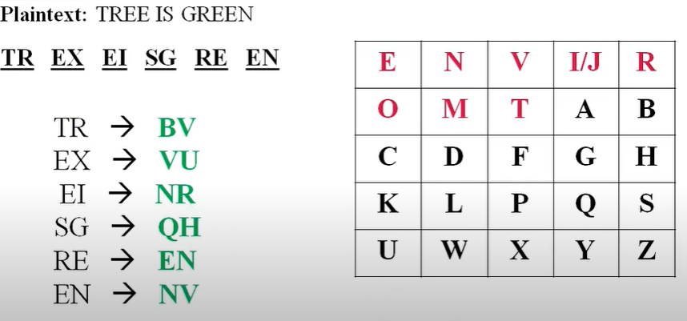
Another Example
Keyword: Environment

Slide 13
Thanks!
Any questions?
You can post your questions on Google Classroom.

